Slide 1
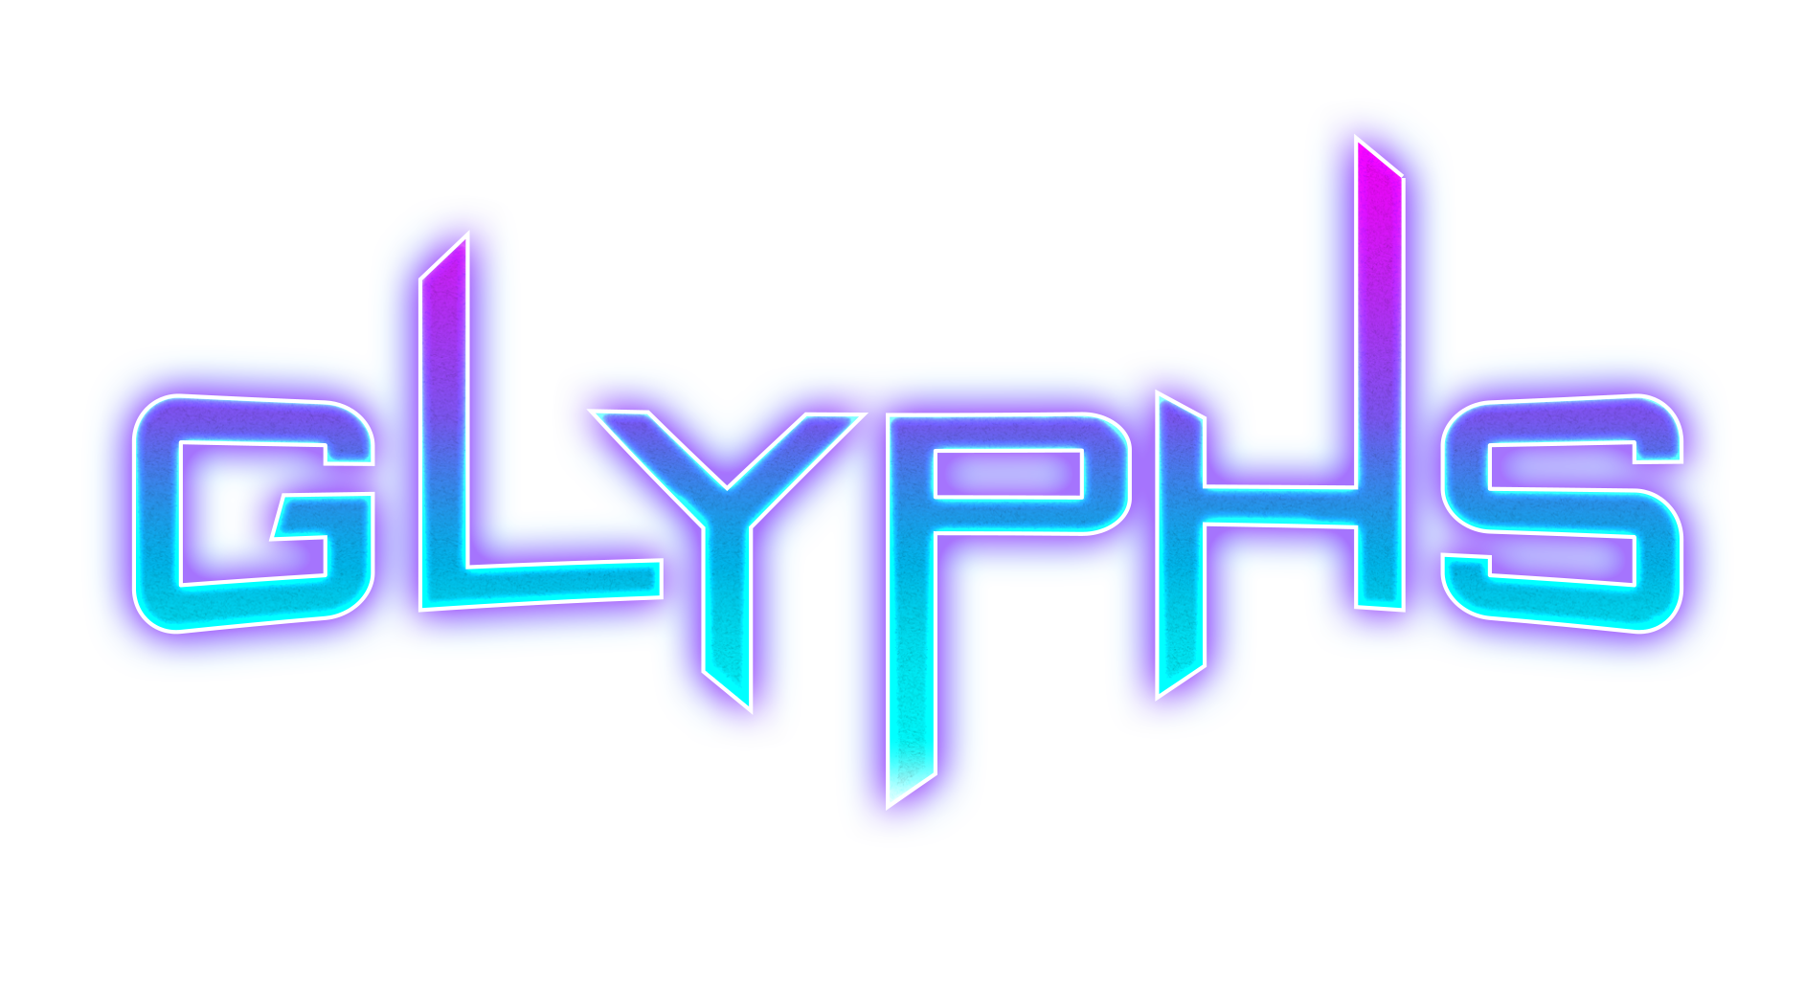
Flow and Feature Map

Slide 2
SCREEN FLOW
√
√
Splash Screen
Main Menu
100
√
√
√
Shop
530
Leaderboards
520
Achievements
510
Options
500
√
√
NEW PLAYR
Social Connect
000
Facebook Auth.
000
1P
√
2P
√
Level Select
200
Active Games List
300
√
Challenge Players
310
√
Add / Send Moves
460
Rematch
√
√
WIN
√
Pre-game (2p)
320
Fail
440
Success
450
√
Pre-game (1p)
210
2P
√
√
1P
WIN
√
Watch Sequence
400
Respond
410
Success
430
YES
Replay
√
Fail
420

Slide 3
1P Flow
Main Menu
Level Select
Pre-game
LVL 1
SELECTED
Pre-game
Tutorial Text
3,2,1
Watch Sequence
3,2,1
Watch Sequence
Tutorial Text
Respond with Sequence
Respond with Sequence
Fail
WIN
WIN
Fail
Success
Success
Next Level

Slide 4
GUI/UX Designs

Slide 5
Transitions

Slide 6
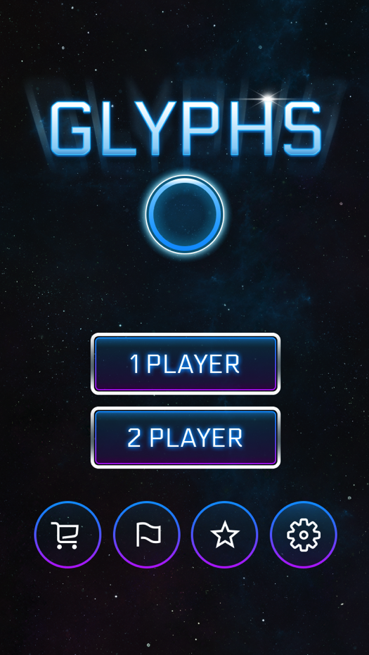
General Screen Transitions
For any screen that is not in the key game flow it should not use the loading screen.
Using the crosshairs as a guide any menu screen’s items should fly away from the center point.
While moving away from the center point items should increase in size and appear to fly off the screen to the screen edges.
New screen items do the same thing, but from small to large and originate from the center point.

Slide 7
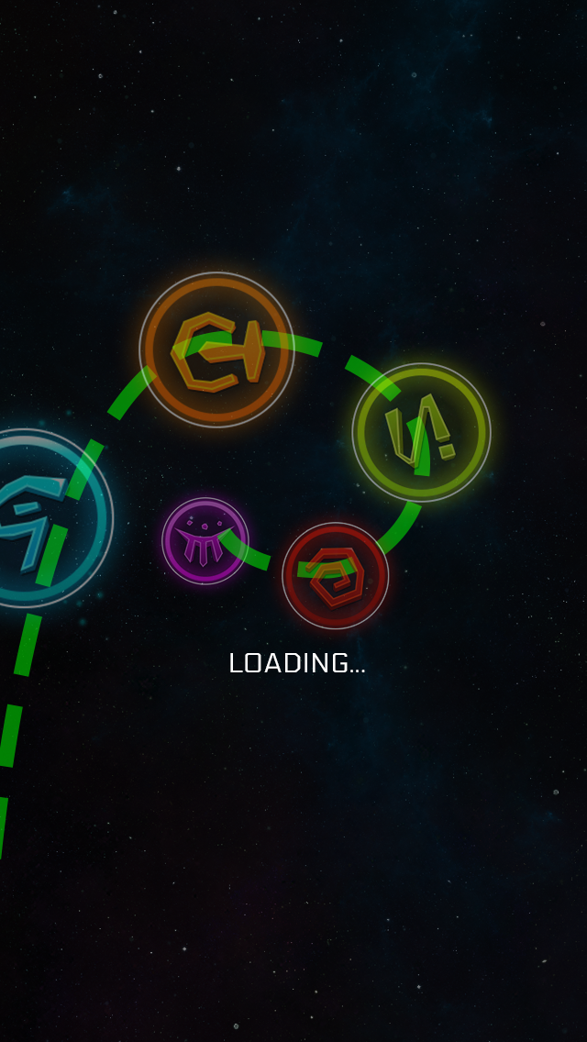
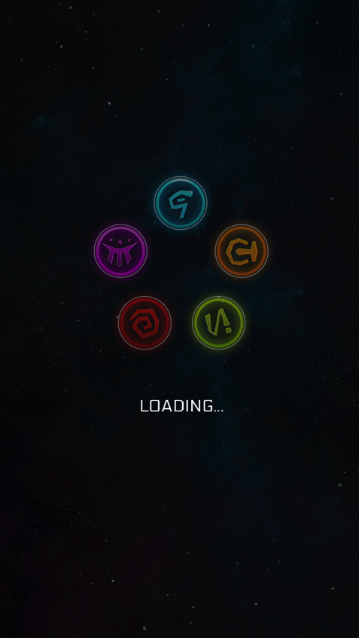
Loading In and Out of Game Screens
For all game screens leading into the core game screens, the symbols fly in from the side clockwise and into their spinning motion. (See green dotted line in reference)
At the end of the game screens the symbols fly out in the same motion, but to the top, right corner opposite from which direction they originally entered.

Slide 8
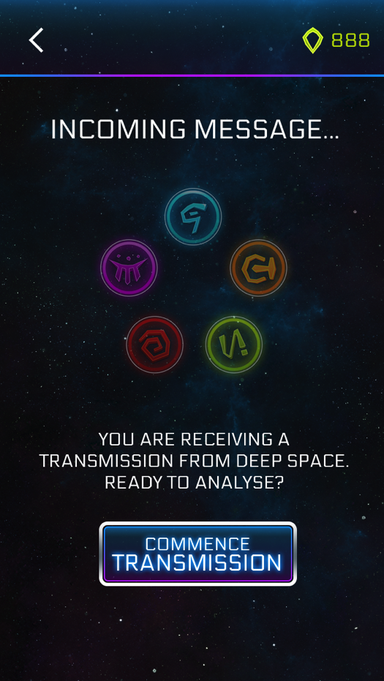
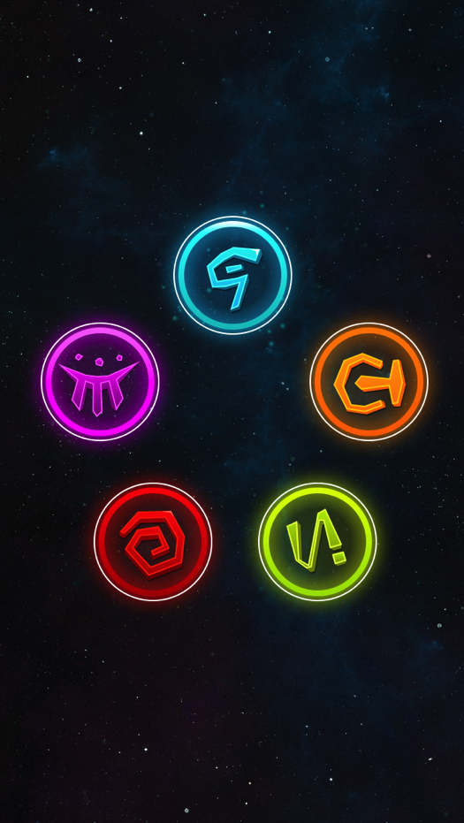
Game Screen Transitions
Through the 1P and 2P game flows, there are break points. At these break points we put the symbols into their “waiting” state. They spin slowly in clockwise position waiting for the next input.
Once the user chooses to continue, the symbols become opaque and larger while they spin and stop into their proper position for the main game screen.
Starting and stopping clockwise animations should ease in and out to reduce abrupt stops and starts.

Slide 9
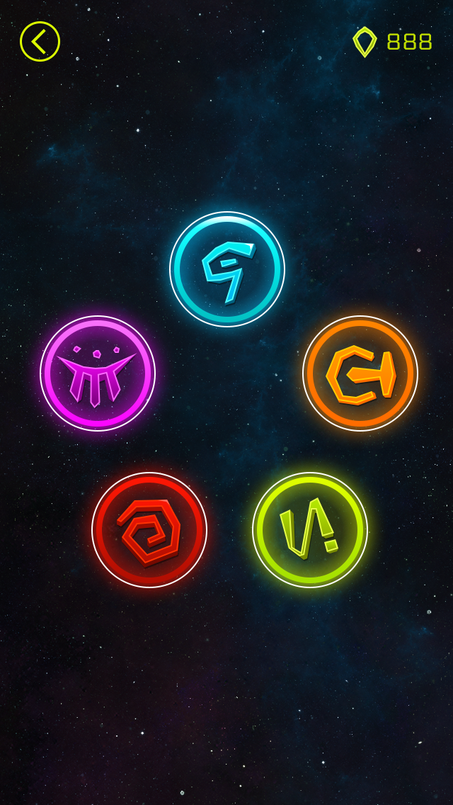
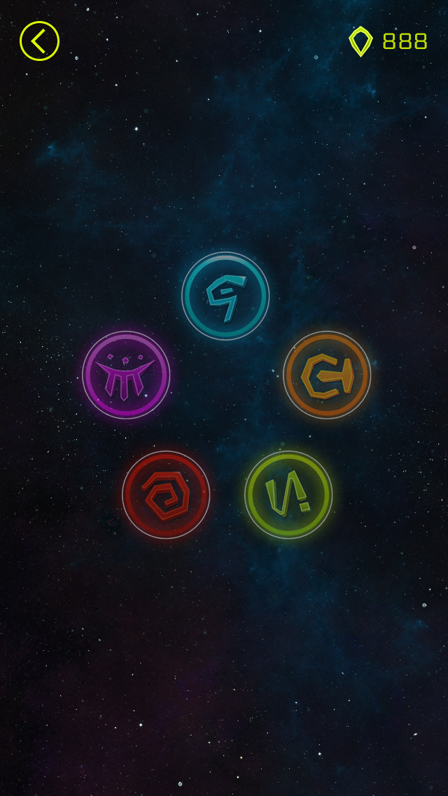
Game Play UX
ACTIVE GAME PLAY
When transitioning between sequences outside the first time, the game does not stop the user flow. There should only be button options (play, next) when the users is successful or fails at the total sequence.
If the user response sequence is successful, the glyphs reset to default position (no rotation) for .25s (editable in Unity) then resumes full size to play the next sequence for the user.
If sequence is failed at any point, the level fail screen is presented to the user.
SUCCESSFUL SEQUENCE TRANSITION

